Slide 1
Platinum Clusters on Al₂O₃ (hcp0001) Surface

Slide 2
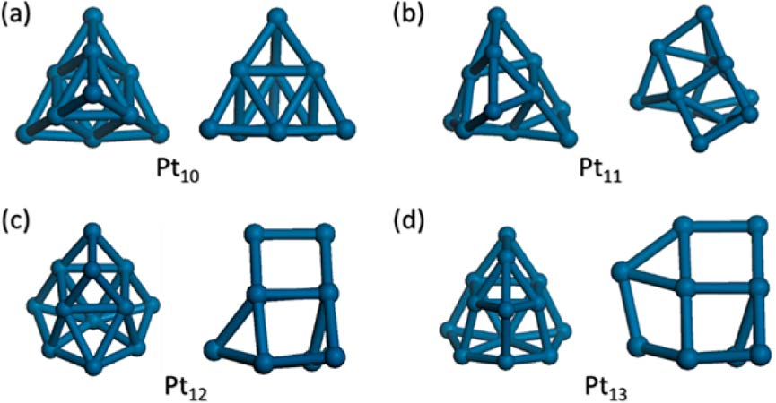
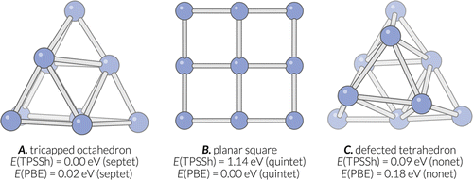
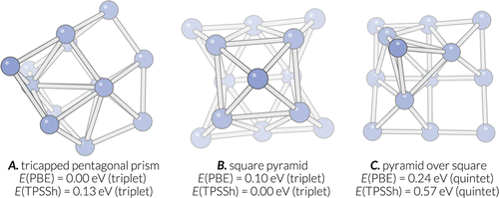
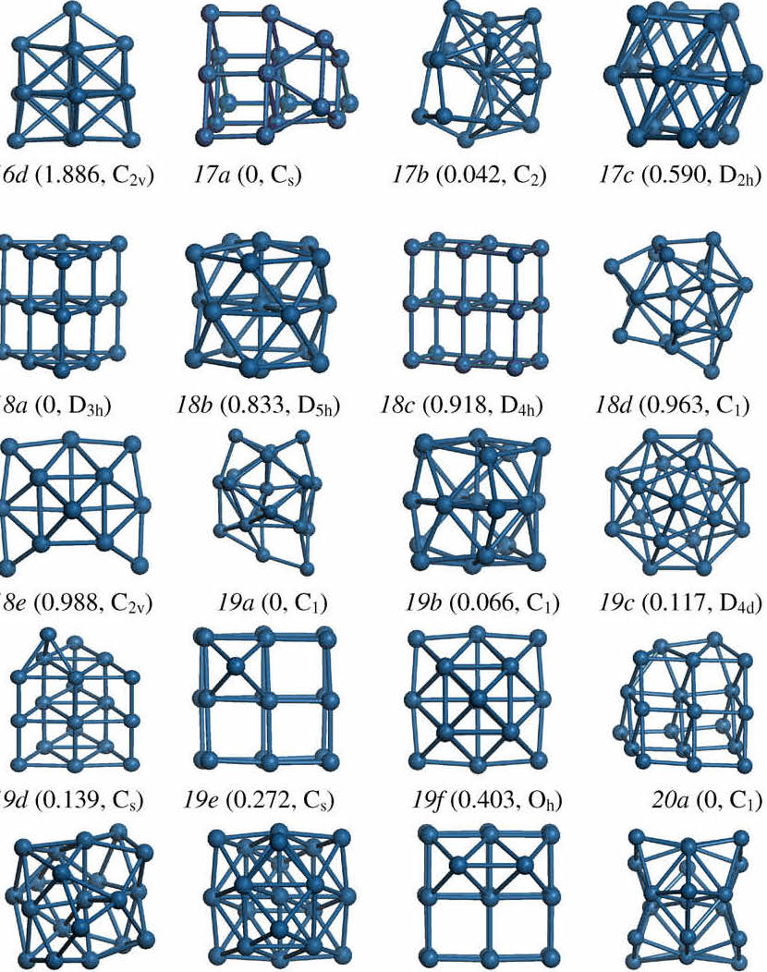
Bare Platinum Clusters
DFT-BH
DNN-BH
Jiang et. al., J. Phys. Chem. C 2017, 121, 10796−10802
Alexandrova et al., J. Chem. Theory Comput. 2016, 12, 6213−6226
Pt₉
X. Wang, D. Tian / Computational Materials Science 46 (2009) 239–244
Pt₁₃
EP-BH

Slide 3
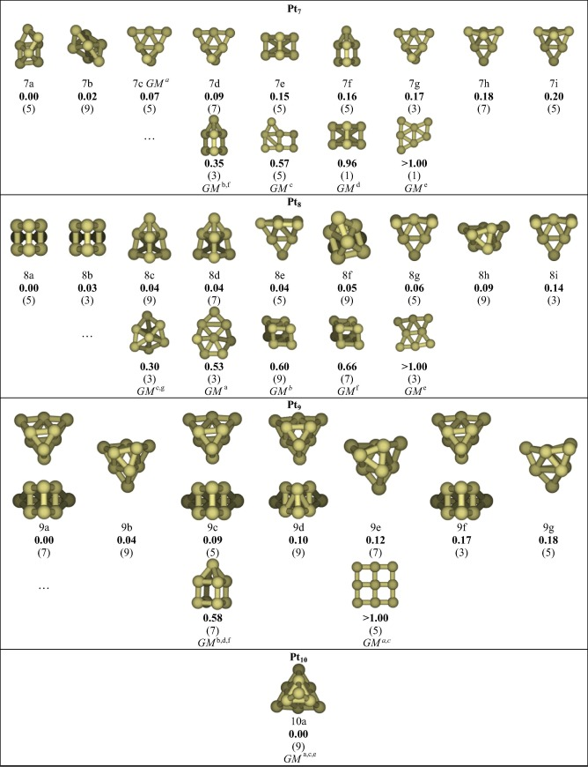
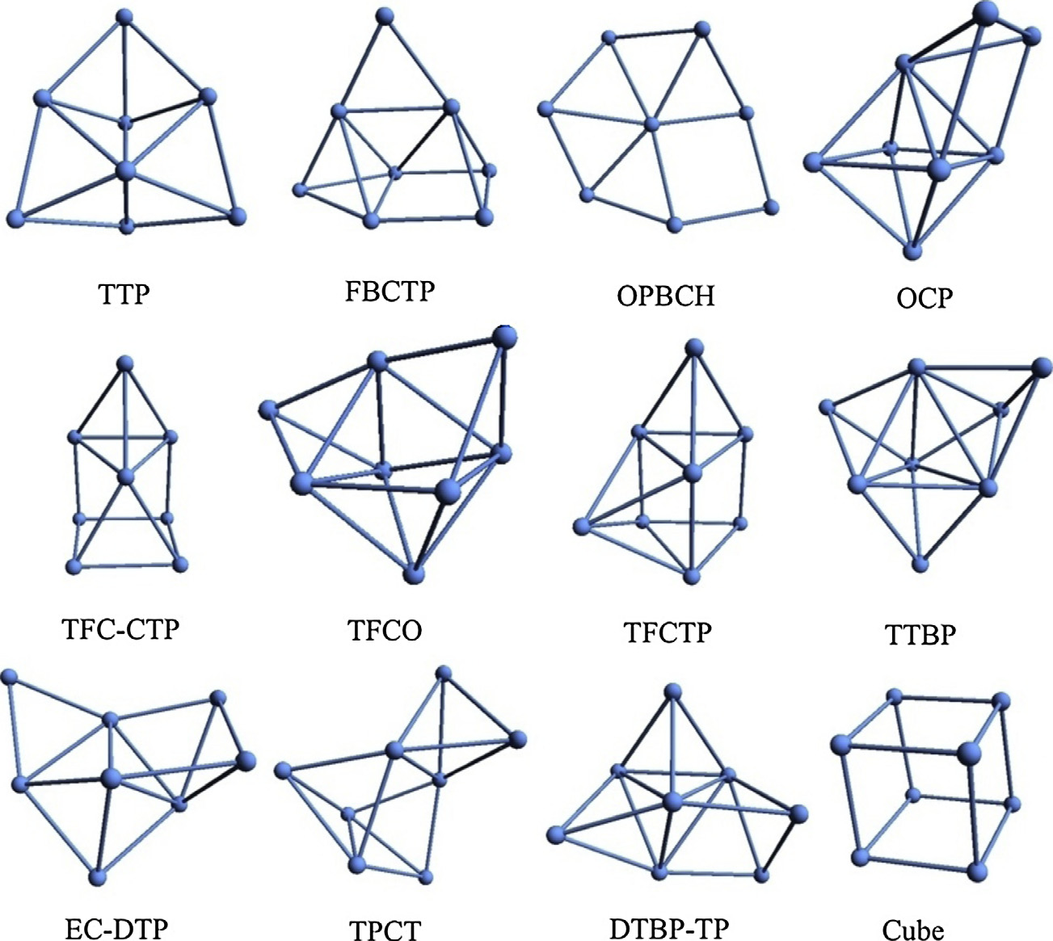
Bare Platinum Clusters
Pt7-Pt10
Rui Li, Marc Odunlami, Philippe Carbonnière,
Computational and Theoretical Chemistry 1107 (2017) 136–141
Pt8
Ali Sebetci
Computational Materials Science 78 (2013) 9–11

Slide 4
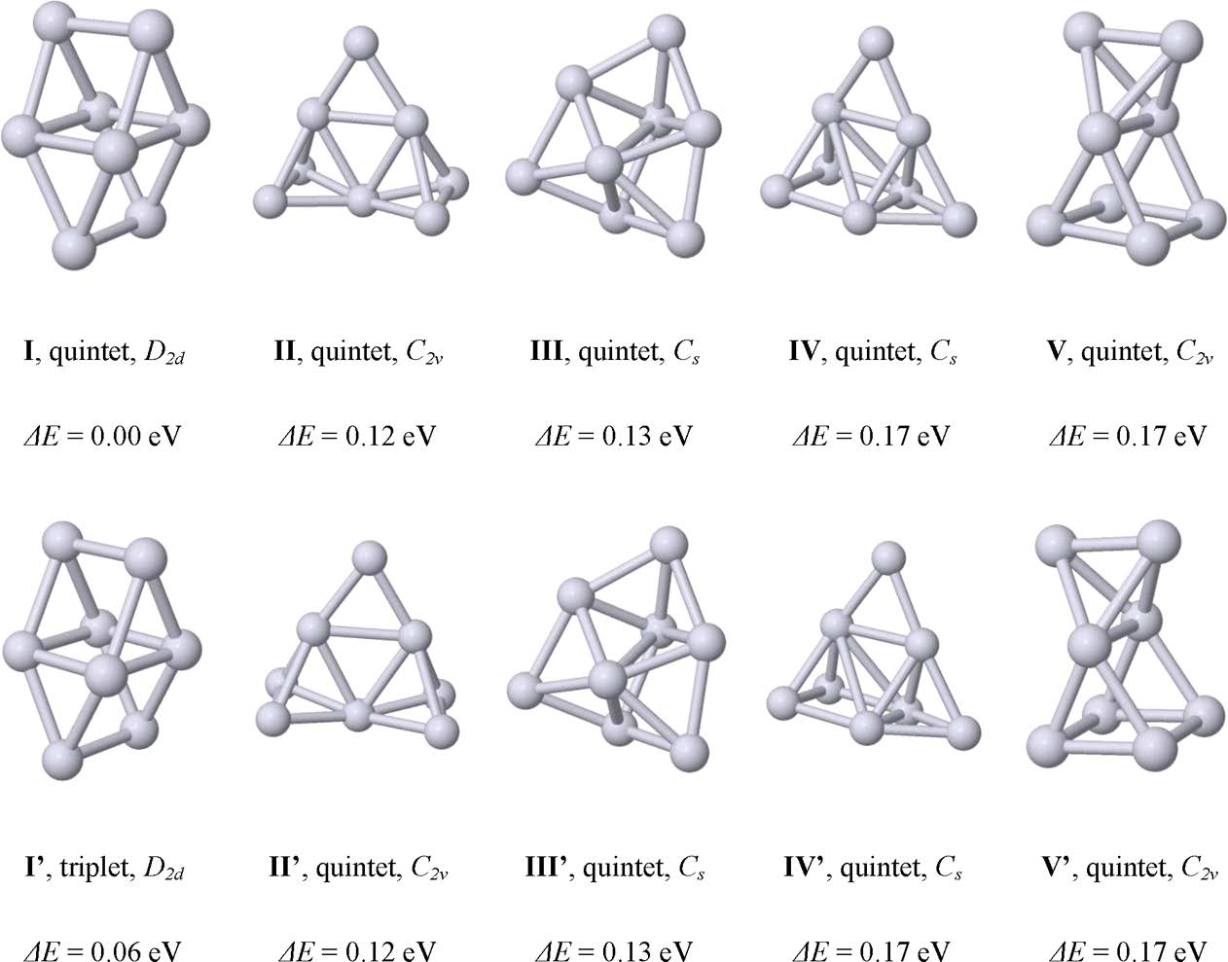
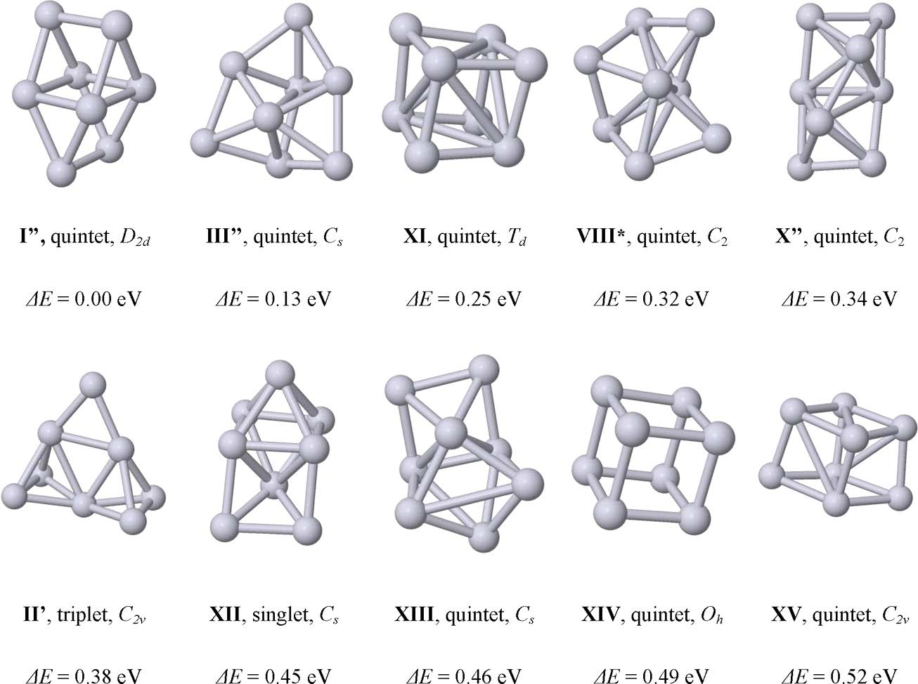
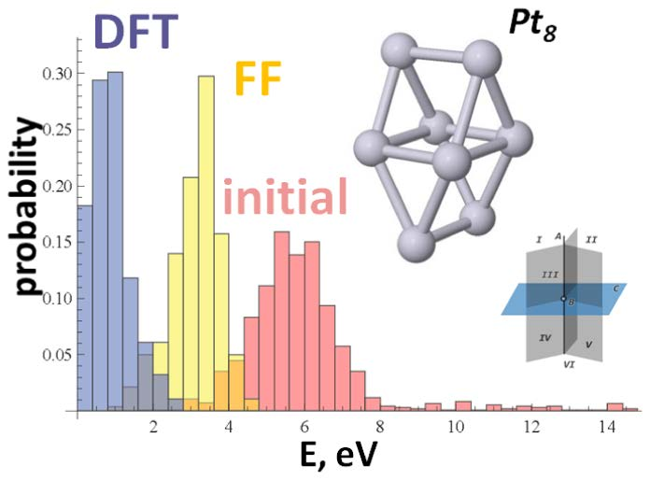
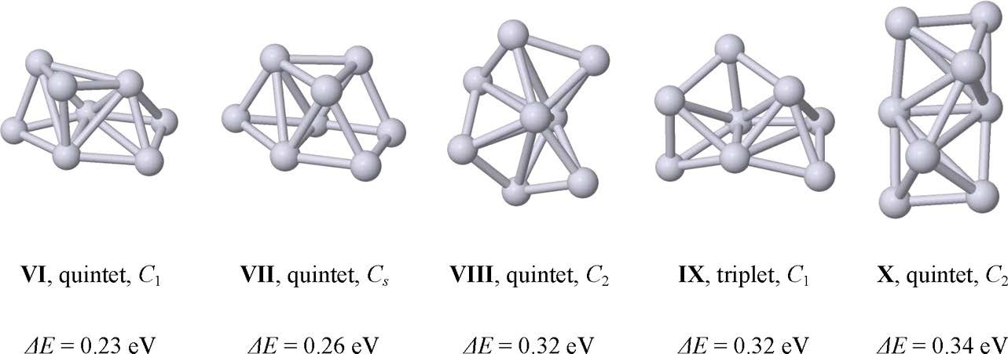
Bare Platinum Clusters
Pt8 Isomers
Anastassia N. Alexandrova J. Chem. Theory Comput. 2015, 11, 2385−2393

Slide 5
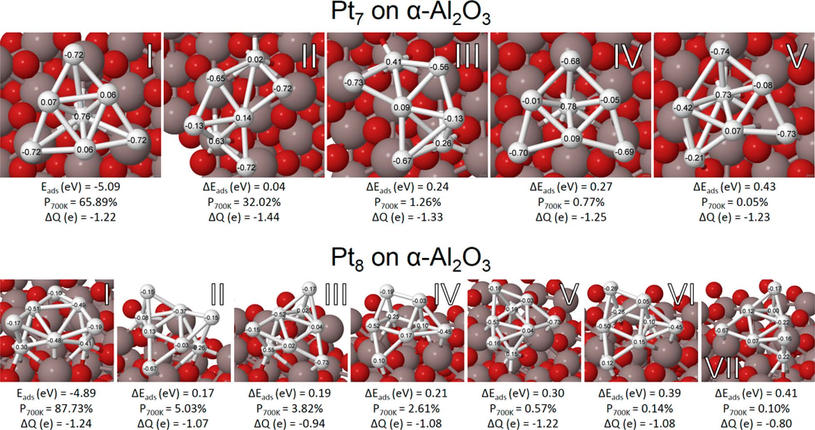
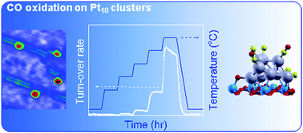
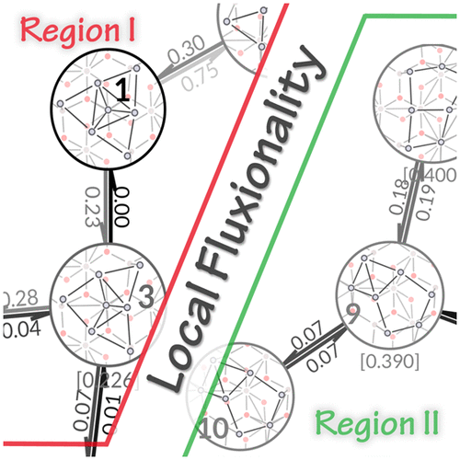
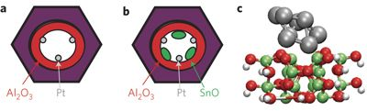
Al₂O₃ Support Based Pt Clusters
Dehydrogenation Reactions :
Anderson et al., ACS Catal. 2017, 7, 3322−3335
b) Oxidation Reactions:
Yin et al., J. Mater. Chem. A, 2017, 5, 4923–4931
Alexandrova et al., J. Phys. Chem. Lett. 2018, 9, 1696−1702
c) Oxidative dehydrogenation Reactions:
Vajda et al., Nature Materials volume 8, pages 213–216 (2009)

Slide 6
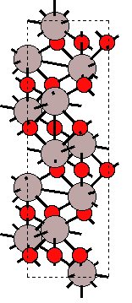
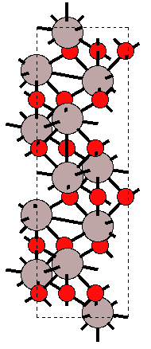
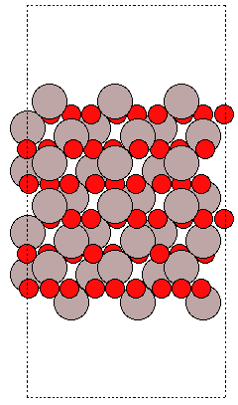
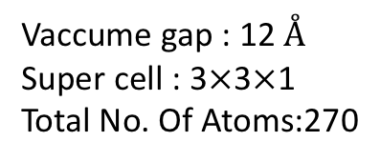
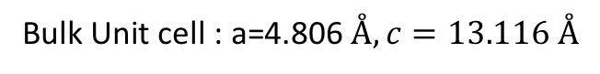
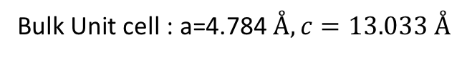
Al₂O₃ Surface Preparation(hcp0001)
Energy fitness
Strain filter
Bulk Unit cell : a=4.806$Å, c=13.116 Å$
Bulk Unit cell : a=4.784$Å, c=13.033 Å$
Vaccume gap : 12 $Å$
Super cell : 3$×$3$×$1
Total No. Of Atoms:270
ase.surface()

Slide 7
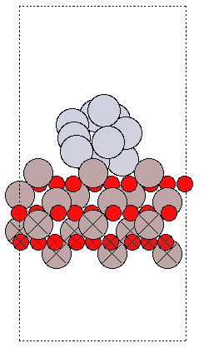
On-the fly Fitting of KRR Model
Generate Initial Population
SP DFT setup:
Mode: LCAO
Basis set: dzp
Kpts=111
Train the Model
Generate new child structures with mutation operations
Up date the population
Relax with Model
Select best fitness structure
Calculate SP DFT

Slide 8
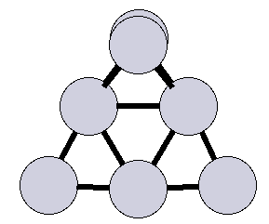
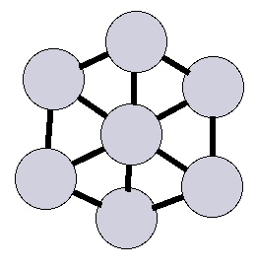
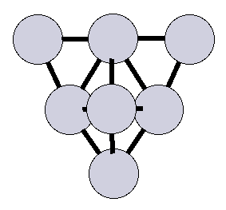
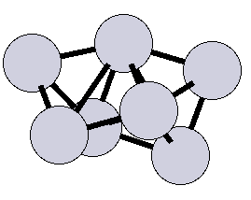
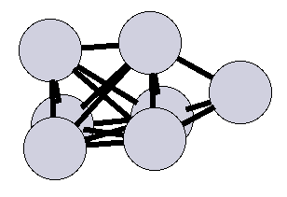
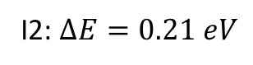
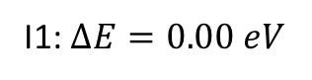
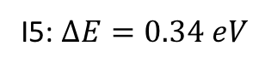
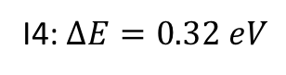
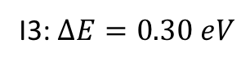
Bare Pt₇ cluster
I1: $∆E=0.00 eV$
I2: $∆E=0.21 eV$
I3: $∆E=0.30 eV$
I4: $∆E=0.32 eV$
I5: $∆E=0.34 eV$

Slide 9
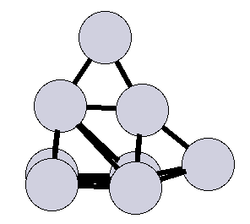
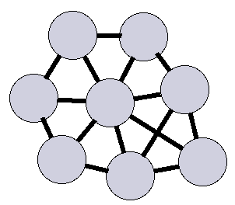
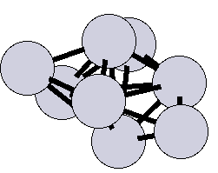
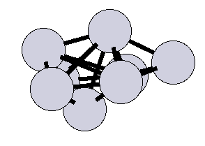
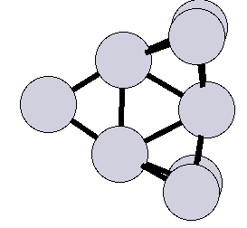
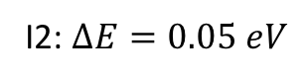
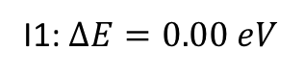
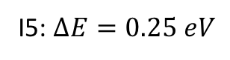
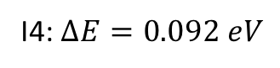
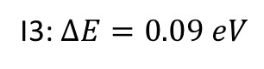
Bare Pt₈ cluster
I1: $∆E=0.00 eV$
I2: $∆E=0.05 eV$
I3: $∆E=0.09 eV$
I4: $∆E=0.092 eV$
I5: $∆E=0.25 eV$

Slide 10
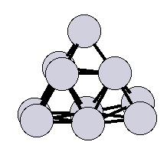
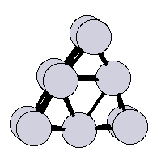
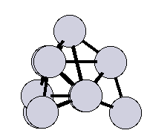
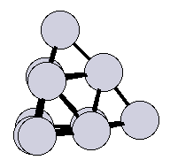
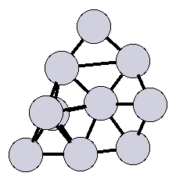
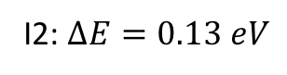
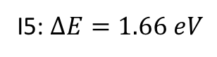
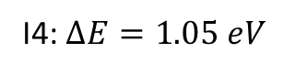
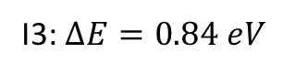
Bare Pt₁₀ cluster
I1: $∆E=0.00 eV$
I2: $∆E=0.13 eV$
I3: $∆E=0.84 eV$
I4: $∆E=1.05 eV$
I5: $∆E=1.66 eV$

Slide 11







Bare Pt₁₃ cluster
I1: $∆E=0.00 eV$
I2: $∆E=0.09 eV$
I3: $∆E=0.24 eV$
I4: $∆E=0.29 eV$

Slide 12










Pt₇ clusters (Alexandrova et al., )
I1: $∆E=0.00 eV$
I2: $∆E=0.029 eV$
I3: $∆E=0.036 eV$
I4: $∆E=0.091 eV$
I5: $∆E=0.233 eV$

Slide 13












Pt₇ clusters (Alexandrova et al., )
I6: $∆E=0.322 eV$
I7: $∆E=0.341 eV$
I8: $∆E=0.394 eV$
I9: $∆E=0.423 eV$
I10: $∆E=0.425 eV$
I11: $∆E=0.446 eV$

Slide 14












Pt₇ clusters (Alexandrova et al., )
I12: $∆E=0.477 eV$
I13: $∆E=0.502 eV$
I14: $∆E=0.544 eV$
I15: $∆E=0.571 eV$
I16: $∆E=0.595 eV$
I17: $∆E=0.619 eV$

Slide 15










Pt₇ clusters (Alexandrova et al., )
I18: $∆E=0.644 eV$
I19: $∆E=0.654 eV$
I20: $∆E=0.734 eV$
I21: $∆E=0.784 eV$
I22: $∆E=0.876 eV$

Slide 16










Pt₇ clusters
I1: $∆E=0.00 eV$
I2: $∆E=0.060 eV$
I3: $∆E=0.143 eV$
I5: $∆E=0.150 eV$
I6: $∆E=0.160 eV$

Slide 17












Pt₇ clusters
I7: $∆E=0.171 eV$
I8: $∆E=0.209 eV$
I9: $∆E=0.401 eV$
I10: $∆E=0.493 eV$
I11: $∆E=0.495 eV$
I12: $∆E=0.497 eV$

Slide 18










Pt₇ clusters
I13: $∆E=0.498 eV$
I14: $∆E=0.688 eV$
I15: $∆E=0.702 eV$
I16: $∆E=0.763 eV$
I17: $∆E=1.304 eV$

Slide 19











Pt₈ clusters
I1: $∆E=0.00 eV$
I2: $∆E=0.186 eV$
I3: $∆E=0.188 eV$
I4: $∆E=0.193 eV$
I5: $∆E=0.251 eV$
I6: $∆E=0.288 eV$
1) Alexandrova et al., ACS Catal. 2017, 7, 3322−3335

Slide 20












Pt₈ clusters
I7: $∆E=0.347 eV$
I8: $∆E=0.423 eV$
I9: $∆E=0.457 eV$
I10: $∆E=0.471 eV$
I11: $∆E=0.504 eV$
I12: $∆E=0.518 eV$

Slide 21












Pt₈ clusters
I13: $∆E=0.620 eV$
I14: $∆E=0.626 eV$
I15: $∆E=0.678 eV$
I16: $∆E=0.680 eV$
I17: $∆E=0.737 eV$
I18: $∆E=0.761 eV$

Slide 22










Pt₈ clusters
I19: $∆E=0.796 eV$
I20: $∆E=0.866 eV$
I21: $∆E=0.899 eV$
I22: $∆E=0.918 eV$
I23: $∆E=0.919 eV$

Slide 23









Pt₁₀ clusters
I1: $∆E=0.00 eV$
I2: $∆E=0.454 eV$
I3: $∆E=0.468 eV$
I4: $∆E=0.469 eV$
I5: $∆E=0.616 eV$
I6: $∆E=0.670 eV$

Slide 24











Pt₁₀ clusters
I7: $∆E=0.739 eV$
I8: $∆E=0.810 eV$
I9: $∆E=0.871 eV$
I10: $∆E=0.895 eV$
I11: $∆E=0.897 eV$
I12: $∆E=0.920 eV$

Slide 25










Pt₁₃ clusters
I1: $∆E=0.000 eV$
I2: $∆E=0.080 eV$
I3: $∆E=0.232 eV$
I4: $∆E=0.243 eV$
I5: $∆E=0.244 eV$
I6: $∆E=0.244 eV$

Slide 26











Pt₁₃ Clusters
I7: $∆E=0.329 eV$
I8: $∆E=0.366 eV$
I9: $∆E=0.389 eV$
I10: $∆E=0.403 eV$
I11: $∆E=0.426 eV$
I12: $∆E=0.477 eV$

Slide 27






Pt₁₃ Clusters
I13: $∆E=0.640 eV$
I14: $∆E=0.939 eV$
I15: $∆E=1.088eV$
I16: $∆E=1.862 eV$

Slide 28






Pt₇ clusters
Pt₇$+O2 \underset{→}{\text{Al}2O3\left(0001\right) surface}$
I1: $∆E=0.00 eV$
I2: $∆E=0.032 eV$
I3: $∆E=0.13 eV$
I4: $∆E=0.16 eV$
I5: $∆E=0.44 eV$

Slide 29










Pt₇ clusters
Pt₇$+O2 \underset{→}{\text{Al}2O3\left(0001\right) surface}$
I6: $∆E=0.45 eV$
I7: $∆E=0.456 eV$
I8: $∆E=0.458 eV$
I9: $∆E=0.500 eV$
I10: $∆E=0.535 eV$
I11: $∆E=0.551 eV$

Slide 30






Pt₇ clusters
Pt₇$+ 2 O2 \underset{→}{\text{Al}2O3\left(0001\right) surface}$
I1: $∆E=0.00 eV$
I2: $∆E=0.223 eV$
I3: $∆E=0.417 eV$
I4: $∆E=0.442 eV$
I5: $∆E=0.489 eV$

Slide 31







Pt₇ clusters
Pt₇$+2O2 \underset{→}{\text{Al}2O3\left(0001\right) surface}$
I6: $∆E=0.512 eV$
I7: $∆E=0.515 eV$
I8: $∆E=0.679 eV$
I9: $∆E=0.68 eV$
I10: $∆E=0.861 eV$

Slide 32





Pt₇ clusters
Pt₇$+3O2 \underset{→}{\text{Al}2O3\left(0001\right) surface}$
I1: $∆E=0.00 eV$
I2: $∆E=0.20 eV$
I3: $∆E=0.30 eV$
I4: $∆E=0.40 eV$
I5: $∆E=0.409 eV$

Slide 33






Pt₇ clusters
Pt₇$+3O2 \underset{→}{\text{Al}2O3\left(0001\right) surface}$
I6: $∆E=0.56 eV$
I7: $∆E=0.564 eV$
I8: $∆E=0.58 eV$
I9: $∆E=0.591 eV$
I10: $∆E=0.599 eV$

Slide 34











Pt₇ clusters
Pt₇$+6 O2 \underset{→}{\text{Al}2O3\left(0001\right) surface}$
I1: $∆E=0.00 eV$
I2: $∆E=0.081 eV$
I3: $∆E=0.215 eV$
I4: $∆E=0.323 eV$
I5: $∆E=0.401 eV$

Slide 35








Pt₇ clusters
Pt₇$+6 O2 \underset{→}{\text{Al}2O3\left(0001\right) surface}$
I6: $∆E=0.766 eV$
I7: $∆E=0.914 eV$
I8: $∆E=1.282 eV$
I9: $∆E=1.45 eV$

Slide 36











Pt₇ clusters
Pt₇$+9 O2 \underset{→}{\text{Al}2O3\left(0001\right) surface}$
I1: $∆E=0.00 eV$
I2: $∆E=0.239 eV$
I3: $∆E=0.352 eV$
I4: $∆E=0.726 eV$
I5: $∆E=0.906 eV$

Slide 37




Pt₇ clusters
Pt₇$+9 O2 \underset{→}{\text{Al}2O3\left(0001\right) surface}$
I6: $∆E=1.059 eV$
I7: $∆E=1.197 eV$

Slide 38







Pt₁₀ clusters
Pt₁₀$+O2 \underset{→}{\text{Al}2O3\left(0001\right) surface}$
I1: $∆E=0.00 eV$
I2: $∆E=0.20 eV$
I3: $∆E=0.228 eV$
I4: $∆E=0.35 eV$
I5: $∆E=0.39 eV$
I6: $∆E=0.40 eV$

Slide 39








Pt₁₀ clusters
Pt₁₀$+2 O2 \underset{→}{\text{Al}2O3\left(0001\right) surface}$
I1: $∆E=0.00 eV$
I2: $∆E=0.497 eV$
I3: $∆E=0.533 eV$
I4: $∆E=0.652 eV$
I5: $∆E=0.689 eV$
I6: $∆E=0.692 eV$

Slide 40










Pt₁₀ clusters
Pt₁₀$+3 O2 \underset{→}{\text{Al}2O3\left(0001\right) surface}$
I1: $∆E=0.000 eV$
I2: $∆E=0.199 eV$
I3: $∆E=0.210 eV$
I4: $∆E=0.373 eV$
I5: $∆E=0.481 eV$
I6: $∆E=0.584 eV$

Slide 41











Pt₁₀ clusters
Pt₁₀$+6 O2 \underset{→}{\text{Al}2O3\left(0001\right) surface}$
I1: $∆E=0.000 eV$
I2: $∆E=0.008 eV$
I3: $∆E=0.561 eV$
I4: $∆E=0.605 eV$
I5: $∆E=0.769 eV$

Slide 42




Pt₁₀ clusters
Pt₁₀$+6 O2 \underset{→}{\text{Al}2O3\left(0001\right) surface}$
I6: $∆E=0.796 eV$
I7: $∆E=0.859 eV$

Slide 43











Pt₁₀ clusters
Pt₁₀$+9 O2 \underset{→}{\text{Al}2O3\left(0001\right) surface}$
I1: $∆E=0.000 eV$
I2: $∆E=0.08 eV$
I3: $∆E=0.336 eV$
I4: $∆E=0.663 eV$
I5: $∆E=2.000 eV$

Slide 44











Pt₁₃ clusters
Pt₁₃$+ O2 \underset{→}{\text{Al}2O3\left(0001\right) surface}$
I1: $∆E=0.000 eV$
I2: $∆E=0.096 eV$
I3: $∆E=0.244 eV$
I4: $∆E=0.485 eV$
I5: $∆E=0.522 eV$

Slide 45










Pt₁₃ clusters
Pt₁₃$+ O2 \underset{→}{\text{Al}2O3\left(0001\right) surface}$
I6: $∆E=0.541 eV$
I7: $∆E=0.651 eV$
I8: $∆E=0.685 eV$
I4: $∆E=0.719 eV$
I5: $∆E=0.800 eV$

Slide 46








Pt₁₃ clusters
Pt₁₃$+ O2 \underset{→}{\text{Al}2O3\left(0001\right) surface}$
I11: $∆E=0.871 eV$
I12: $∆E=1.030 eV$
I13: $∆E=1.157 eV$
I14: $∆E=1.272 eV$

Slide 47











Pt₁₃ clusters
Pt₁₃$+2 O2 \underset{→}{\text{Al}2O3\left(0001\right) surface}$
I1: $∆E=0.000 eV$
I2: $∆E=0.468 eV$
I3: $∆E=0.577 eV$
I4: $∆E=0.602 eV$
I5: $∆E=0.647 eV$

Slide 48










Pt₁₃ clusters
Pt₁₃$+2 O2 \underset{→}{\text{Al}2O3\left(0001\right) surface}$
I6: $∆E=0.672 eV$
I7: $∆E=0.715 eV$
I8: $∆E=0.723 eV$
I4: $∆E=0.723 eV$
I5: $∆E=0.786 eV$

Slide 49








Pt₁₃ clusters
Pt₁₃$+2 O2 \underset{→}{\text{Al}2O3\left(0001\right) surface}$
I11: $∆E=0.799 eV$
I12: $∆E=0.837 eV$
I13: $∆E=0.862 eV$
I14: $∆E=1.344 eV$

Slide 50











Pt₁₃ clusters
Pt₁₃$+3 O2 \underset{→}{\text{Al}2O3\left(0001\right) surface}$
I1: $∆E=0.000 eV$
I2: $∆E=0.238 eV$
I3: $∆E=0.7007 eV$
I4: $∆E=0.858 eV$
I5: $∆E=0.886 eV$

Slide 51






Pt₁₃ clusters
Pt₁₃$+3 O2 \underset{→}{\text{Al}2O3\left(0001\right) surface}$
I6: $∆E=0.956 eV$
I7: $∆E=1.129 eV$
I8: $∆E=1.206 eV$

Slide 52










Pt₁₃ clusters
Pt₁₃$+6 O2 \underset{→}{\text{Al}2O3\left(0001\right) surface}$
I1: $∆E=0.000 eV$
I2: $∆E=0.157 eV$
I3: $∆E=0.217 eV$
I4: $∆E=0.295 eV$
I5: $∆E=0.305 eV$

Slide 53












Pt₁₃ clusters
Pt₁₃$+6 O2 \underset{→}{\text{Al}2O3\left(0001\right) surface}$
I6: $∆E=0.394 eV$
I7: $∆E=0.435 eV$
I8: $∆E=0.498 eV$
I9: $∆E=0.835 eV$
I10: $∆E=0.903 eV$
I11: $∆E=1.591 eV$

Slide 54











Pt₁₃ clusters
Pt₁₃$+9 O2 \underset{→}{\text{Al}2O3\left(0001\right) surface}$
I1: $∆E=0.000 eV$
I2: $∆E=0.775 eV$
I3: $∆E=1.088 eV$
I4: $∆E=1.259 eV$
I5: $∆E=2.815 eV$

Slide 55



Hydroxylation of Al₂O₃(0001) Surface
$$H2O \underset{→}{\text{Al}2O3\left(0001\right) surface}$$
I1: $∆E=0.00 eV$
I2: $∆E=0.42 eV$

Slide 56






Pt₇ clusters
Pt₇$+H2O \underset{→}{\text{Al}2O3\left(0001\right) surface}$
I1: $∆E=0.00 eV$
I2: $∆E=0.07 eV$
I3: $∆E=0.13 eV$
I4: $∆E=0.26 eV$
I5: $∆E=0.42 eV$

Slide 57




Pt₇ clusters
Pt₇$+H2O \underset{→}{\text{Al}2O3\left(0001\right) surface}$
I6: $∆E=0.86 eV$
I7: $∆E=0.95 eV$
I8: $∆E=0.99 eV$
I9: $∆E=1.00 eV$

Slide 58





Pt₇ clusters
Pt₇$+H2O \underset{→}{\text{Al}2O3\left(0001\right) surface}$
I10: $∆E=1.06 eV$
I11: $∆E=1.12 eV$
I12: $∆E=1.22 eV$
I13: $∆E=1.29 eV$
I14: $∆E=1.34 eV$

Slide 59





Pt₈ clusters
Pt₈$+H2O \underset{→}{\text{Al}2O3\left(0001\right) surface}$
I1: $∆E=0.00 eV$
I2: $∆E=0.10 eV$
I3: $∆E=0.12 eV$
I4: $∆E=0.24 eV$

Slide 60




Pt₈ clusters
Pt₈$+H2O \underset{→}{\text{Al}2O3\left(0001\right) surface}$
I5: $∆E=0.29 eV$
I6: $∆E=0.51 eV$
I7: $∆E=0.58 eV$
I8: $∆E=0.59 eV$

Slide 61



Pt₈ clusters
Pt₈$+H2O \underset{→}{\text{Al}2O3\left(0001\right) surface}$
I9: $∆E=1.10 eV$
I10: $∆E=1.32 eV$
I11: $∆E=1.95 eV$

Slide 62




Pt₁₀ clusters
Pt₁₀$+H2O \underset{→}{\text{Al}2O3\left(0001\right) surface}$
I1: $∆E=0.00 eV$
I2: $∆E=0.01 eV$
I3: $∆E=0.29 eV$
I4: $∆E=0.82 eV$

Slide 63




Pt₁₀ clusters
Pt₁₀$+H2O \underset{→}{\text{Al}2O3\left(0001\right) surface}$
I5: $∆E=0.88 eV$
I6: $∆E=0.89 eV$
I7: $∆E=1.22 eV$
I8: $∆E=1.58 eV$

Slide 64




Pt₁₃ clusters
Pt₁₃$+H2O \underset{→}{\text{Al}2O3\left(0001\right) surface}$
I1: $∆E=0.00 eV$
I2: $∆E=0.35 eV$
I3: $∆E=0.99 eV$
I4: $∆E=1.17 eV$

Slide 65




Pt₁₃ clusters
Pt₁₃$+H2O \underset{→}{\text{Al}2O3\left(0001\right) surface}$
I5: $∆E=1.76 eV$
I6: $∆E=2.6 eV$
I7: $∆E=2.8 eV$
I8: $∆E=2.9 eV$

Slide 66



Structural Evolution
Pt₇
Pt₁₃
Pt₈
Pt₁₀
Pt₇$+O2 \underset{→}{\text{Al}2O3}$
Pt₇$+2O2 \underset{→}{\text{Al}2O3}$
Pt₇$+H2O \underset{→}{\text{Al}2O3}$

Slide 67




Formation Energies By addition of O₂ Molecule
E_{bind} = E_{tot.} (n O₂ + Pt_{n}) / Al₂O₃(0001)) - n E_{tot}(O₂) - E_{tot}(Pt_{n} + Al₂O₃(0001))
Pt₇
Pt₁₀
Pt₁₃
Pt₇ + O₂
Pt₁₀ + O₂
E_{f} = 0.00 eV
E_{f} = 0 eV
Pt₁₀ + 2 O₂
E_{f} = 0 eV
Pt₇ + 2 O₂
E_{f} = -4.30 eV
E_{f} = -3.92 eV
Pt₁₀ + 3 O₂
$∆$E = 3.81 eV
E_{f} = -4.66 eV
$∆$E = 3.99 eV
Pt₇ + 3 O₂
E_{f} = -7.73 eV
E_{f} = -8.29 eV
$∆$E = 3.54 eV
$∆$E = 3.47 eV
E_{f} = -8.97 eV
Pt₇ + 6 O₂
E_{f} = -11.27 eV
E_{f} = -11.76 eV
E_{f} = -17.35 eV
E_{f} = -12.64 eV

Slide 68











Structural Evolution of Pt₇
I1: $∆E=0.00 eV$
I1: $∆E=0.00 eV$
I1: $∆E=0.00 eV$
I2: $∆E=0.081 eV$
I4: $∆E=0.320 eV$
I2: $∆E=0.21 eV$
I3: $∆E=0.30 eV$
I2: $∆E=0.060 eV$
I1: $∆E=0.00 eV$
I1: $∆E=0.00 eV$
I1: $∆E=0.00 eV$

Slide 69






Structural Evolution of Pt₁₀
I5: $∆E=1.66 eV$
I9: $∆E=0.871 eV$
I1: $∆E=0.00 eV$
I1: $∆E=0.000 eV$
I1: $∆E=0.000 eV$
I4: $∆E=1.05 eV$
I1: $∆E=0.00 eV$
I1: $∆E=0.00 eV$
I1: $∆E=0.000 eV$
I3: $∆E=0.336 eV$

Slide 70










Structural Evolution of Pt₁₃
I3: $∆E=0.24 eV$
I1: $∆E=0.000 eV$
I1: $∆E=0.000 eV$
I1: $∆E=0.000 eV$
I2: $∆E=0.157 eV$
I2: $∆E=0.09 eV$
I2: $∆E=0.080 eV$
I1: $∆E=0.000 eV$
I1: $∆E=0.000 eV$
I1: $∆E=0.000 eV$

Slide 71



Phase Diagrams for Pt₇, Pt₁₀, Pt₁₃ at different Oxide Composition

Slide 72
Observations of Current Results
At no/low O₂ loading, the Pt/PtO clusters were formed.
At high O₂ loading, 2 dimensional Pt oxide rafts were formed.
At saturated O₂ loading, no Pt-Pt bonds were observed and only Pt-O bonds on the surface.
At saturated O₂ loading, one Pt some how connects with other Pt only by bridging O atoms.

Slide 73
Success Plots
Pt₇
No. Of restarts : 18
Pt₈
Pt₁₀
Pt₁₃
Pt₁₉

Slide 74
Pt₇ Success rate

Slide 75
Pt₈ Success rate
Kernel width : 0.5, Mas similarity : 0.06, Kappa : 2, population size : 5
No relaxation of slab with ML potential

Slide 76
Pt₈ Success rate
Kernel width : 0.5, Mas similarity : 0.06, Kappa : 2, population size : 5
No relaxation of slab with ML potential

Slide 77
Pt₈ Success rate
Kernel width : 0.5, Mas similarity : 0.03, Kappa : 4, population size : 6
No relaxation of slab with ML potential

Slide 78
Pt₈ Success rate
Kernel width : 0.5, Mas similarity : 0.03, Kappa : 4, population size : 6
No relaxation of slab with ML potential

Slide 79
Pt₇ Success rate
Pt₇ O₁₂ Success rate
Pt₇ O₁₈ Success rate

Slide 80
Pt₁₀ Success rate
Pt₁₀ O₁₂ Success rate
Pt₁₀ O₁₈ Success rate

Slide 81
Pt₁₃ Success rate
Pt₁₃ O₁₂ Success rate
Pt₁₃ O₁₈ Success rate

Slide 82


Pt₈ Success rate (without relaxing slab)
Kernel width : 0.5, No relaxation of slab with ML potential
Predefined Slab

Slide 83


Pt₈ Success rate (without relaxing slab)

Slide 84


Pt₈ Success rate (with relaxing slab)
Kernel width : 0.5, Mas similarity : 0.05, Kappa : 2,
population size : 6
Slab relaxation with ML potential : dmax_cov=0.5,
steps=50,zlim=none
Success rate : 0 %
Kernel width : 0.5, Mas similarity : 0.05, Kappa : 2,
population size : 10
Slab relaxation with ML potential : dmax_cov=0.05,
steps=10,zlim=none
Success rate : 5 %

Slide 85
Methodology Problems
Descriptor should be local because if we want to add data while transforming one system
like Pt7/a-Al2O3(0001) to another system like (H2O+Pt7)/a-Al2O3(0001)
2) In order to include surface relaxations it requires large amount of data due to global descriptor
3)

Slide 86


DFT Investigation of Intermediate Steps in the Hydrolysis of $α$-Al2O3(0001)
$$H2O \underset{→}{\text{Al}2O3\left(0001\right) surface}$$
An attractive interaction between H and OH favors 1-2 dissociation across a connected Als-Os fragment, and dissociation is exothermic with respect to gas-phase or adsorbed water.
Al_{s}O_{s,3}+H₂O $→$ (HO)Al_{s}O_{s,2}+O_{s}H ΔE₁ = -1.57 eV
Top and side views of saturation coverage water adsorption states: (a) molecular water bilayer, (b) monolayer Als-hydroxylated surface, (c) monolayer Als-hydroxylated surface with molecular water, (d) fully hydroxylated, “gibbsite-like” surface, and (e) fully hydroxylated surface with molecular water overlayer. In color version, orange, magenta, and dark blue labeled spheres indicate Os, molecular water O, and dissociated water O, respectively. Unlabeled spheres belong to subsurface atoms.
Schneider et al., J. Phys. Chem. C 2009, 113, 2149–2158

Slide 87

DFT Investigation of Intermediate Steps in the Hydrolysis of $α$-Al2O3(0001)
Surface free energy will explain the stability of each phase at different chemical potentials of variable composition when
the system and surroundings are in equilibrium and system is allowed to change in the composition and chemical potential
is nothing but free energy of of component at constant T and P.
The stoichiometric reactions of the Al-terminated surface with H2O studied here can all be written as
Al_{s}+ xH₂O $→\text{Al}\text{s}$_{,θ} H_{3(1-θ)} (H, OH)_{x-3 2(1-θ)} +1/2 (1-θ )Al₂O₃ (s)
Δγ(θ, x) = $\frac{G\left(θ, x\right)−G\left(1, 0\right)+ ½ \left(1−θ\right)GAl2O3 −x μH2O }{\text{A}}$
μ_{H2O} = μ_{H2O}(0)+Δμ ≈ E_{H2O}^{DFT}+ Δμ_{H2O}
G(θ, x) ≈ E(θ, x)
The three most prominent free-energy-minimizing, stable surfaces with increasing H2O potential are the dry surface (Figure 1), the fully hydroxylated (Figure 3d), and the fully hydroxylated with molecular water (Figure 3e).

Slide 88
What is Free Energy (G or A)
The basic definition of "energy" is a measure of a body's (in thermodynamics, the system's) ability to cause change. For example, when a person pushes a heavy box a few meters forward, that person exerts mechanical energy, also known as work, on the box over a distance of a few meters forward. The mathematical definition of this form of energy is the product of the force exerted on the object and the distance by which the box moved (Work=Force x Distance). Because the person changed the stationary position of the box, that person exerted energy on that box. The work exerted can also be called "useful energy". Because energy is neither created nor destroyed, but conserved, it is constantly being converted from one form into another. For the case of the person pushing the box, the energy in the form of internal (or potential) energy obtained through metabolism was converted into work in order to push the box. This energy conversion, however, is not linear. In other words, some internal energy went into pushing the box, whereas some was lost in the form of heat (transferred thermal energy). For a reversible process, heat is the product of the absolute temperature T and the change in entropy S of a body (entropy is a measure of disorder in a system). The difference between the change in internal energy, which is ΔU, and the energy lost in the form of heat is what is called the "useful energy" of the body, or the work of the body performed on an object. In thermodynamics, this is what is known as "free energy". In other words, free energy is a measure of work (useful energy) a system can perform at constant temperature. Mathematically, free energy is expressed as:
free energy A = U - TS.
This expression has commonly been interpreted to mean that work is extracted from the internal energy U while TS represents energy not available to perform work. However, this is incorrect. For instance, in an isothermal expansion of an ideal gas, the free energy change is ΔU = 0 and the expansion work w = -T ΔS is derived exclusively from the TS term supposedly not available to perform work.

Slide 89


DFT characterization of coverage dependent molecular water adsorption modes on a-Al2O3(0001)
To separate the effects of water-surface and water-water interactions, we distinguish between the total binding energy Ebind between the surface and n gas-phase water: and the energy Esep to rigidly separate the partially or fully developed water overlayer (n Æ H2 O) from the surface:
PDOS will explain the stability of specific orbitals near fermi energy relative to the specific elements involved in the reaction
E_{bind} = E_{tot.} (nH2O/alpha-Al2O3(0001) - n E_{tot}(H2O) - E_{tot}(alpha-Al2O3 (0001))
E_{sep} = E_{tot.} (nH2O/alpha-Al2O3(0001) - E_{tot}(n. H2O) - E_{tot}(alpha-Al2O3 (0001))
Surface Science 602 (2008) 268–275

Slide 90
Analysis of Anhydrous and Hydrated Surface Energies of gamma-Al2O3 by Water Adsorption Microcalorimetry
Surface + nads H2 O(gas) ⇔ Surface, nads H2 O(adsorbed)
The Gibbs free energy change associated with eq 4 at a given
temperature and pressure is
ΔG = G(Surface, n_{ads}H2O_{(adsorbed)}) - G(Surface) - n_{ads} $μ$_{H2O}
where μH2O is the chemical potential of water. If the bulk energy remains unchanged with respect to adsorption, one neglects the entropic and pV terms, and the reactions are reversible, using the same notation in eq 3, we have: where θ is the surface coverage, ΔHads is the measured heat of adsorption (kJ.mol−1), and γS is the surface energy at the givensurface coverage.
γ^{S} = γ₀^{S}+ θ.ΔH_{ads}
J. Phys. Chem. C 2012, 116, 24726−24733

Slide 91


Substrate induced reconstruction and activation of platinum clusters: A systematic DFT study
. The average adsorp-tion energy of Ptncluster on -Al2O3surface was calculated as
$∆$E = [E(Pt_{n}/Al2O3) − E(Al2O3) − E(Pt_{n})]/n.
Applied Surface Science 422 (2017) 1075–1081

Slide 92


Future Work
1) Oxidation of Pt on Al₂O₃ surface:
Sangnier et al., J. Phys. Chem. C 2018, 122, 26974−26986
2) Hydroxilation of Al₂O₃ surface:
Wang et al., J. Phys. Chem. C 2011, 115, 13399–13411

Slide 93

Ensemble Average Catalytic Property
From our point of view, the most difficult question is that of
the interdependence and the interaction between the catalyzed
reaction and cluster isomer interconversion. Clusters covered
with reactants may have a diff erent preferred shape or an
ensemble of shapes than those covered with reaction
intermediates or products. However, does it mean that the
cluster rearranges in the course of the reaction step, that is, part
of the reaction coordinate? Alternatively, does it mean that the
clusters interconvert from one to another within the given freeenergy well (say that of the reactants) and, once a particularly catalytic isomer forms in this process of equilibration, the reaction proceeds with a very small barrier? If the latter is the case, then, once the next reaction intermediate is formed, theclusters may again re-equilibrate in the new free-energy well. The generally longer lifetime in the wells should allow for this. At the moment, there is a controversy and a general lack of clarity on this question. How can we begin thinking about it?
1) Alexandrova et al., ACS Catal. 2017, 7, 1905−1911.

Slide 94


Hydroxilation of Alpha-Al2O3 (0001) surface
J. Phys. Chem. C, Vol. 113, No. 6, 2009 2155
J. Phys. Chem. C 2012, 116, 26829−26840

